Slide 1
Infrastructure clouds, microbial genomics, and the Cloud Virtual Resource project (CloVR)
Sam Angiuoli
sangiuoli@som.umaryland.edu

Slide 2
Our community
Microbial genomics
Biologists, MDs, bioinformaticians
Many backgrounds; increasingly inter-disciplinary
Democratization of sequencing
Data acquisition is less of a bottleneck
Many datasets
Including many small to medium in size
Diverse analysis needs
Often exploratory
Evolving protocols

Slide 3
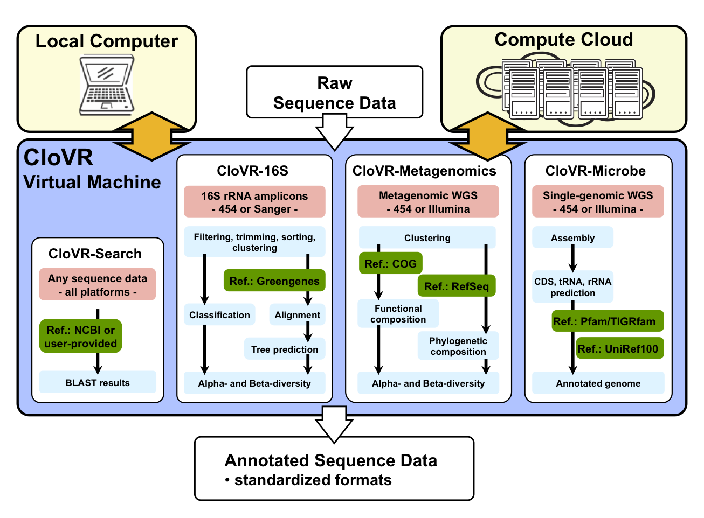
Our project
Integrate analysis software and automated pipelines into a portable VM
VM runs on a local PC and can (optionally) access the Cloud seamlessly on-demand
Funding
NIH
NHGRI

Slide 4
What drew our development team to infrastructure clouds?
Reliability of Amazon EC2
Things just worked
Flexibility
Pipelines and protocols change frequently
Customizable VMs
Independence
Root access
On-demand

Slide 5
How does our community benefit?
Increased throughput
Many small to medium scale needs but more than a desktop can handle
Easy to use
Zero software install
CloVR VM is prebuilt, ready to go
No need for building, managing local cluster
In CloVR, cloud utilization is built-in and seamless
Improved control
CloVR VM runs on the desktop as a stand-alone application
Cloud used for temporary processing only; data is downloaded back to the PC
DIY nature is appealing to many groups
An alternative to uploading data to a third-party web server for analysis

Slide 6
What are the challenges in using clouds?
Poor reliability
Must just work, end-users cannot debug
Cloud and software must be very robust
Ongoing need for testing and good software engineering
Poor availability
What exists outside of commercial space is small
Need more machine types
Limited portability
Despite APIs, not simply write once, run anywhere
Need for more standardization
Authentication
Need for simplified sign-on
Big data
Internet transfers can be prohibitive

